Slide 1


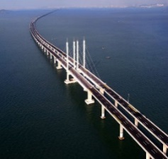

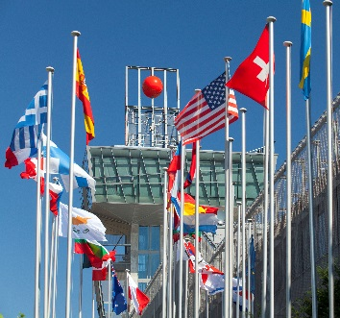
Welcome to
– a gateway to world market on chemical and ecological safety and security
18-20. April 2016

Slide 2
The Global Summit on Chemical Safety and Security
with accompanying
Chemical Safety and Security Fair
18-20. April 2016

Slide 3
Agenda
About the Event
Organizers
Poland – Bridge to Europe
Why participate?

Slide 4
Agenda
About the Event
Organizers
Poland – Bridge to Europe
Why participate?

Slide 5


Objectives
The development of a global market on chemical safety and security free from political considerations and oriented towards operationalization and internationalization of the best existing national and international best practices, capacity building, trainings, technologies and technical solutions.
The event eagers to become the future “must be” place for chemical safety and security practitioners, providers and users.

Slide 6
Idea – 3 Thematic Blocks
Congress
Best Practices Forum
International Fair
Statements and lectures
Demonstrations, best practices exchanges and trainings
Modern solutions and state-of-the-art in chemical and ecological safety and security, with an emphasis on industry

Slide 7
The Global Summit on Chemical Safety and Security
The Summit will be the first global non-political event to address chemical and ecological safety and security and prevent misuse of toxic chemicals in the entire chain of chemical activity, including development, production, transportation, use, storage and disposal of chemicals.
SELECTED TOPICS
Chemical Security Threats today and national and international efforts to mitigate them
Enhancing chemical safety and security in chemical industry, with an emphasis on Small and Medium Enterprises
Industrial security system management programs and their ongoing improvements
Chemical safety and security in the transit of dangerous goods
Cyber security innovations and automation system solutions
Improving chemical and ecological safety and security at local level
Best practices in the area of prevention of major accidents and incident management

Slide 8
CHEM-SAFETY-EXPO
The CHEM-SAFETY-EXPO will exhibit the state of art technologies, products and technical solutions
BRANCH RANGE
Chemical process safety ● Fire and explosion protection ● Transportation of dangerous substances
Cybersecurity at chemical facilities
Health and safety in the workplace ● Emergency services equipment ● Perimeter security ● Personal Protective Equipment
Storage and utilization of dangerous materials ● Laboratory safety and security ● Analytical techniques ● Research and innovation
Procedures, training, certification ● Literature, information, media

Slide 9

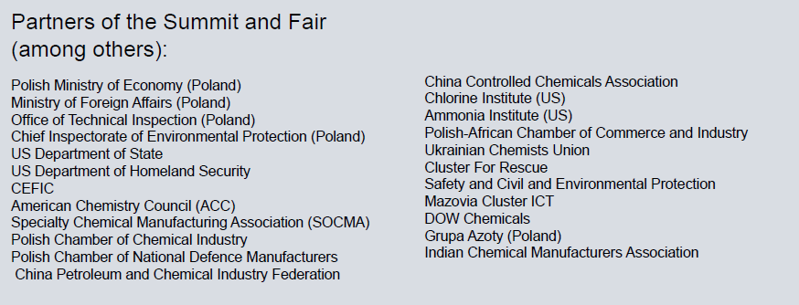
Many important organisations are already involved in the project

Slide 10
Agenda
About the Event
Organizers
Poland – Bridge to Europe
Why participate?

Slide 11

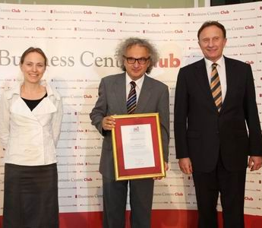



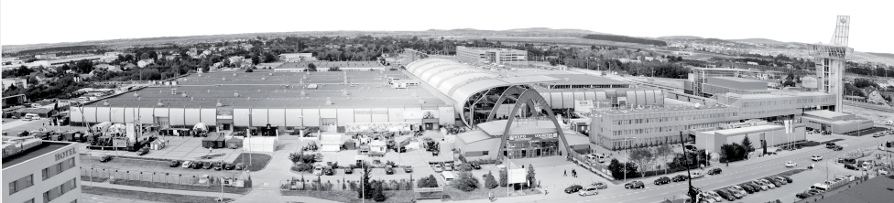
What do We Stand for:
Experience
Know-how
Responsibility
Founded in 1992
160 employees, 70% with high education, Ambassador of Polish Economy title in 2012
The only Poland’s trade fair centre with the ISO Certificate, Member of UFI

Slide 12

One of the Leading Exhibition Centers in Central and Eastern Europe
6500 exhibitors ● 210 000 trade fair visitors ● 200,000 m² rented exhibition space ● almost 160 official delegations from 56 countries of Europe, America and Asia
2nd rank in terms of number of exhibitors in Central and Eastern Europe:
Very good position on Polish market:

Slide 13
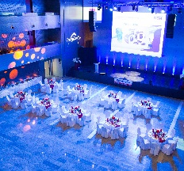
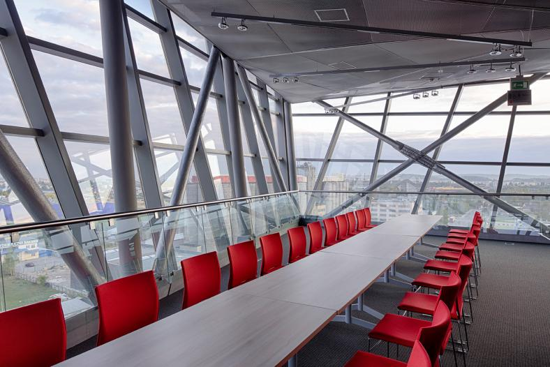
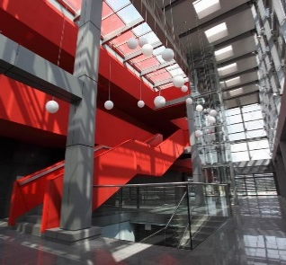
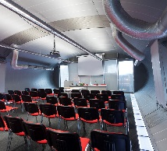
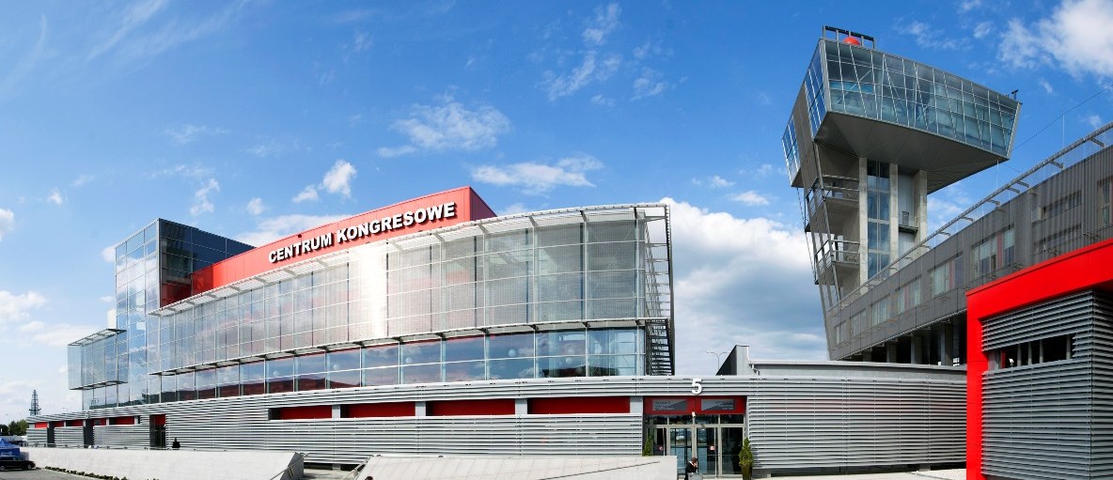
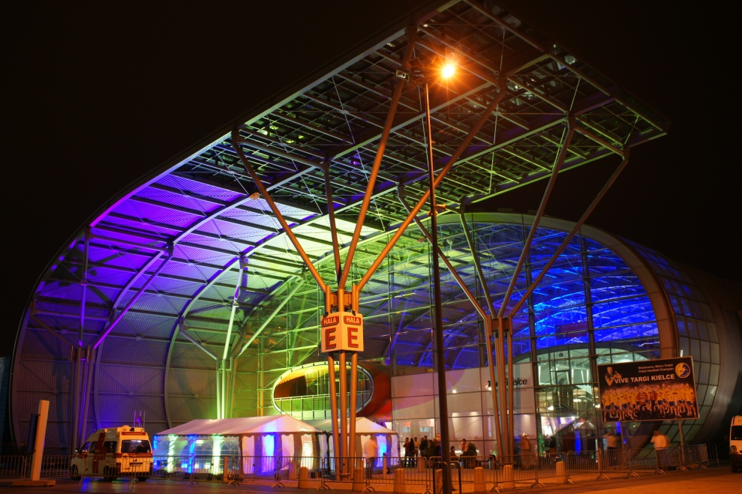
State of the Art Venue
36,000 m² exhibition space in 7 halls ● 90,000 m² total exhibition space 19 conference rooms ● modern congress hall for 850 persons ● banquet hall on 57m tower ● 2.400 parking spaces ● Press centre and the comfortable VIP area

Slide 14
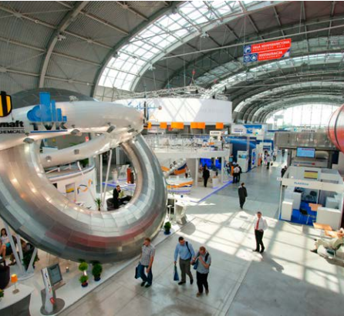
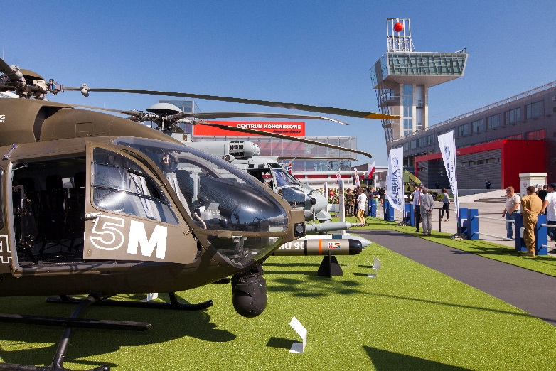
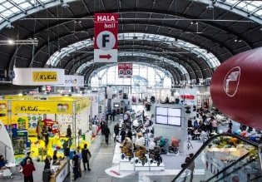
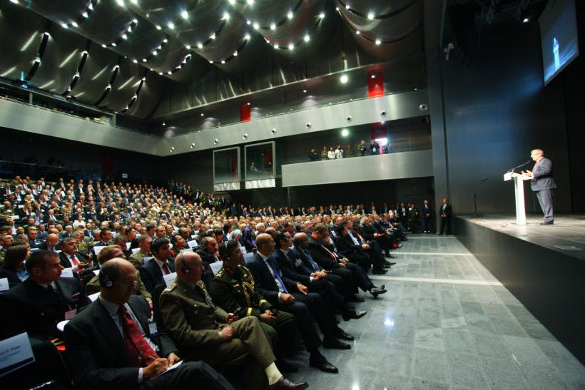
Trusted Meeting Place
70 annual exhibitions ● 700 congresses, conferences, training sessions, concerts, and stage performances annually

Slide 15

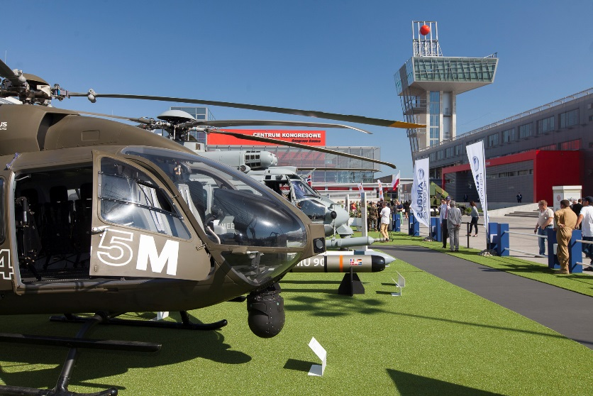
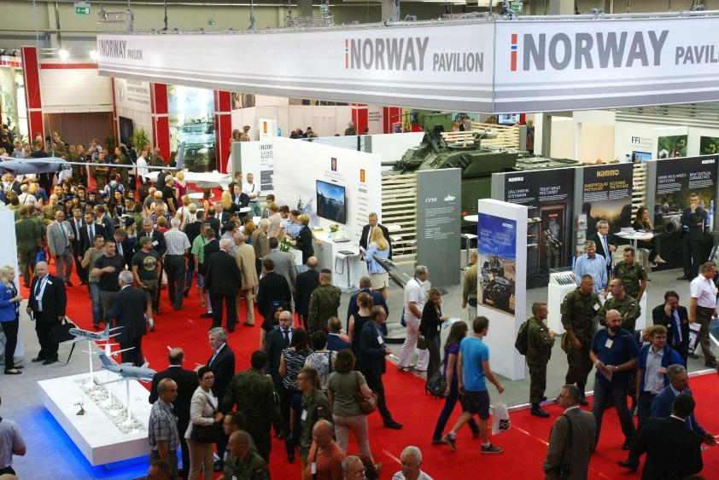
MSPO – International Defence Industry Exhibition
Under the auspices of the President of the Republic of Poland
583
20 000
58
exhibitors
from 30 countries in 2015
professionals attending the event
official delegations from all over the world
…Europe’s third largest military exhibition
ranked after Paris and London …

Slide 16

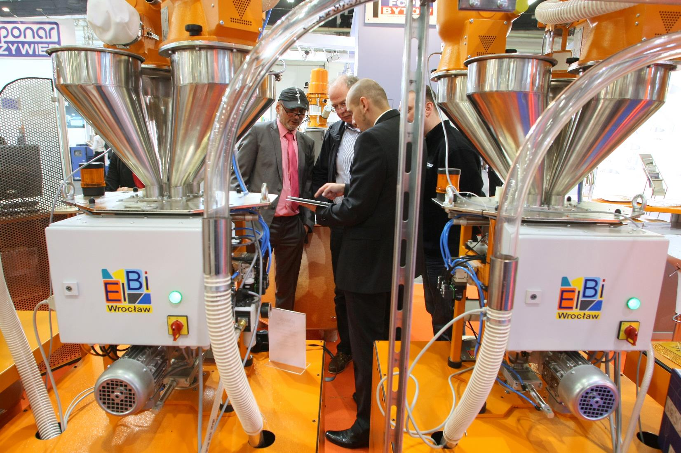
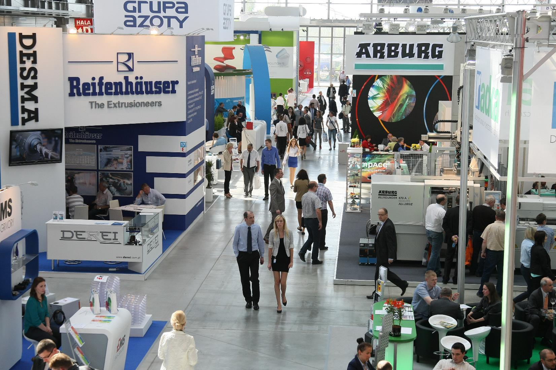
PLASTPOL – International Fair of Plastics and Rubber Processing
over 800
The most multinational trade fair
in Poland which brings together
the largest number of foreign exhibitors
18 000
exhibitors
from 30 countries in 2015
business visitors
…champion among exhibitions: one of Europe’s largest exhibitions devoted to plastics and rubber processing…

Slide 17

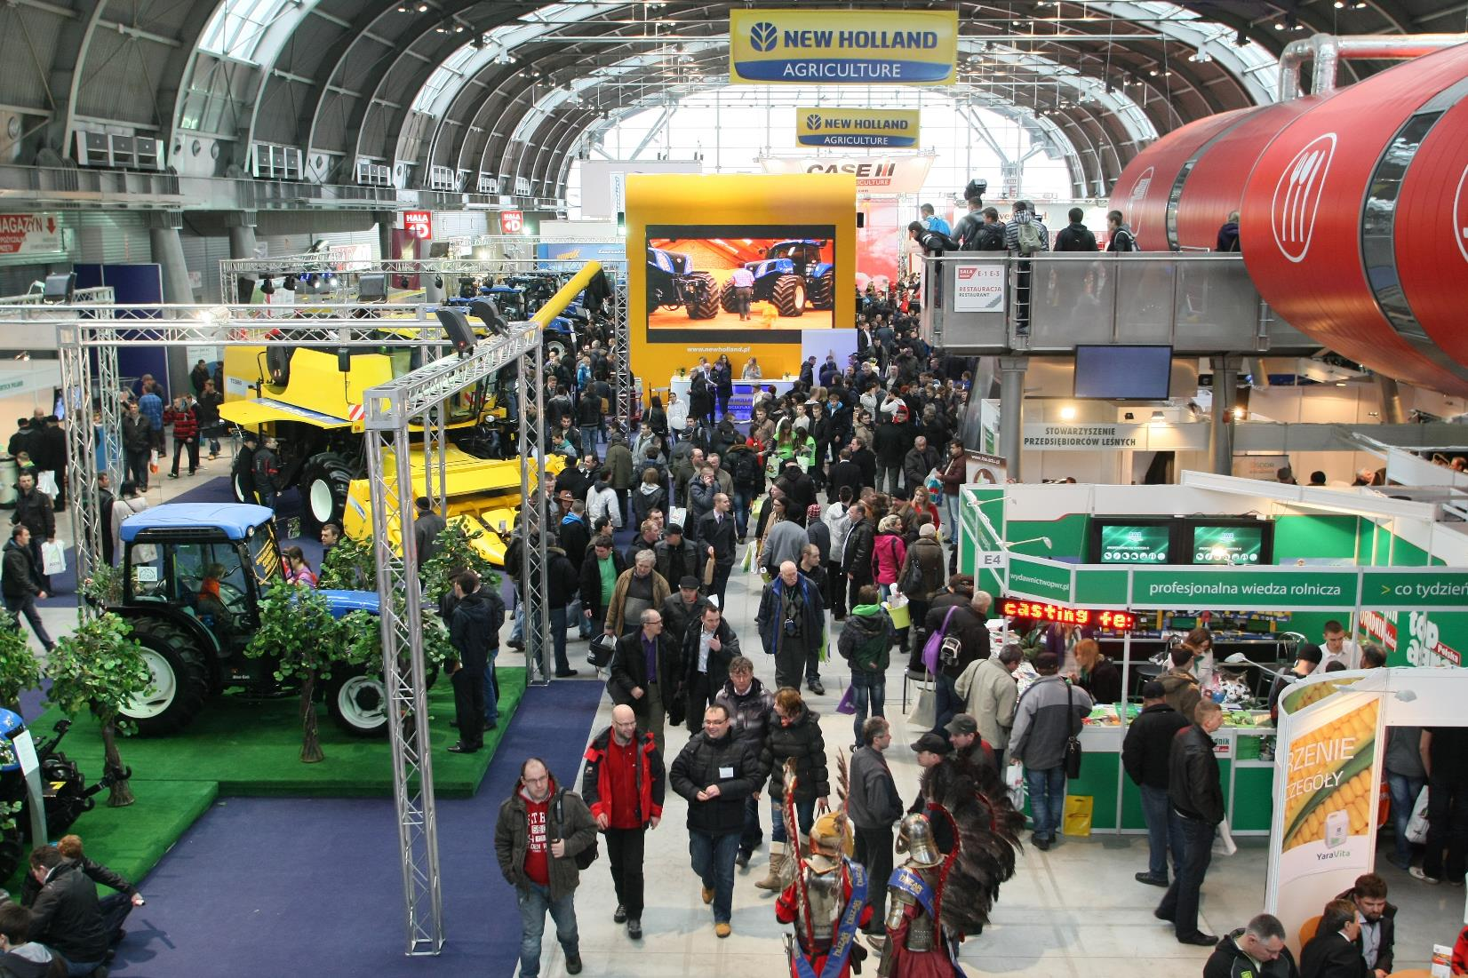
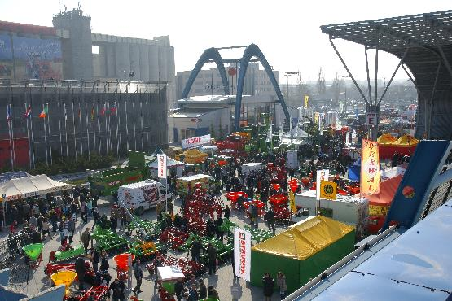
AGROTECH – International Fair of Agricultural Techniques
over
60 000 m²
61 500
950
700
exhibitors from 27 countries in 2015
of the exhibition space
agricultural professionals visiting the exhibition
agricultural machines
The Award of the Minister of Agriculture presented during the trade fair
…Poland’s most frequented trade fair …

Slide 18
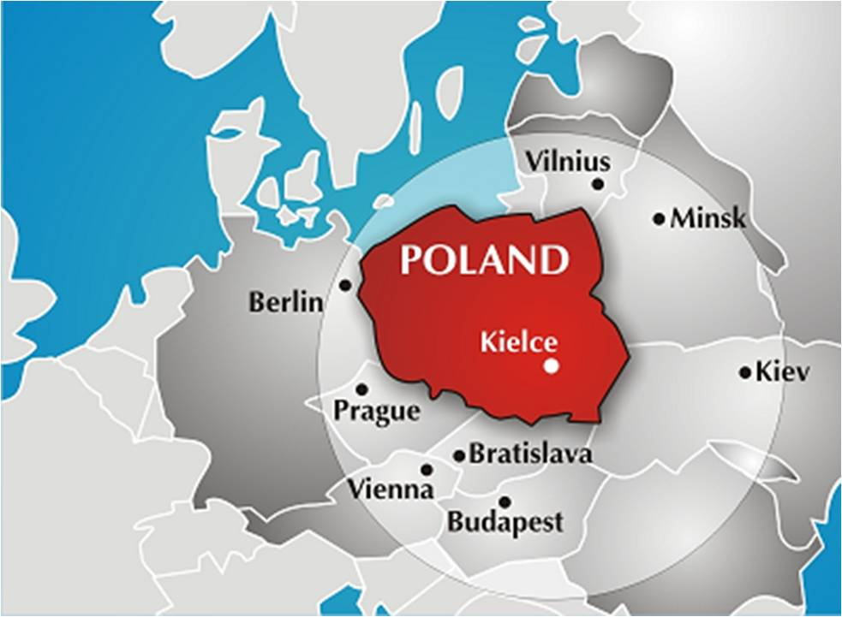
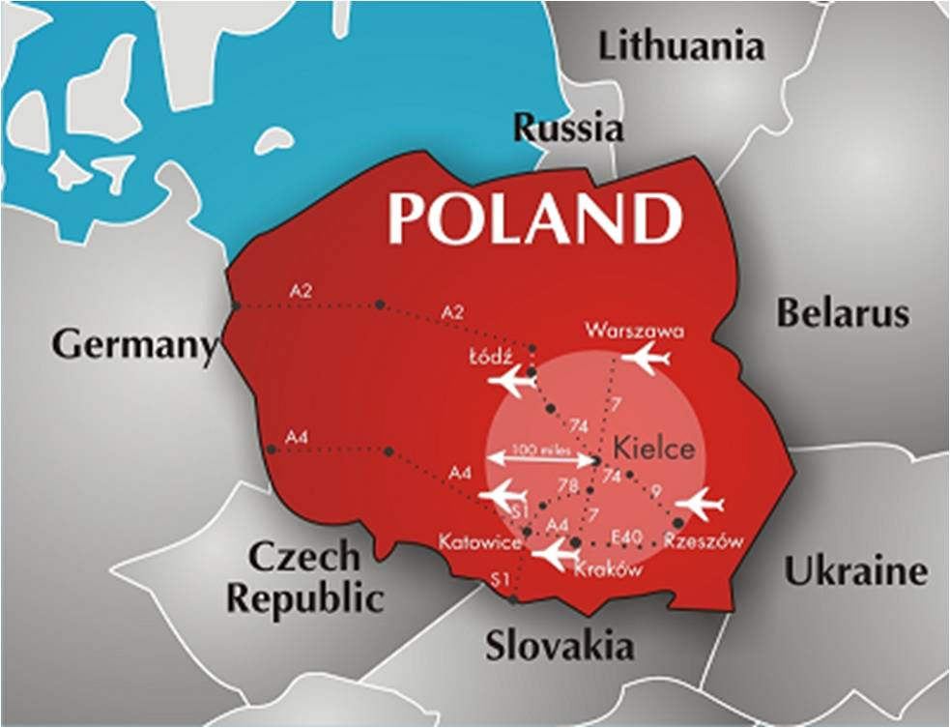
Strategic location
8 European capital cities within the radius of 700 km
250 Mio people within the radius of 1000 km
Centre of continental Europe, between 2 trans-European transport corridors

Slide 19

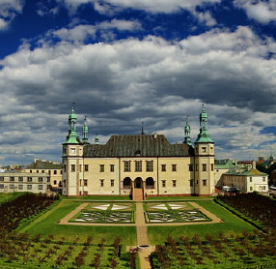

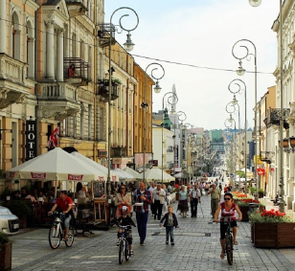
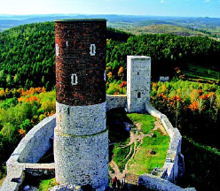
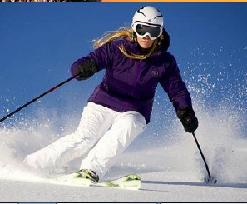
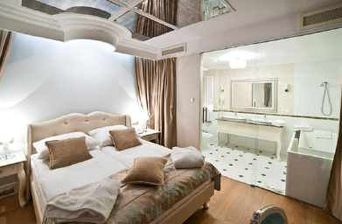
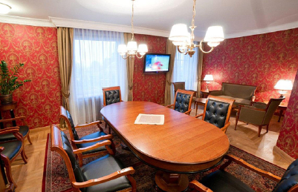

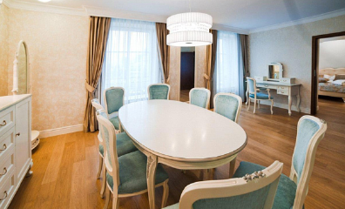
Well developed hotel and entertainment base in the region
77 hotels in the region, almost 6000 places to stay
Numerous tourist attractions to visit around the city

Slide 20
Agenda
About the Event
Organizers
Poland – Bridge to Europe
Why participate?

Slide 21

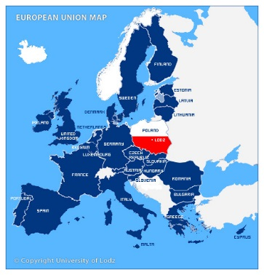

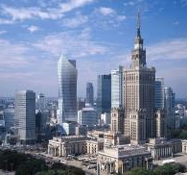
POLAND – Bridge to Europe
Poland, based on its favourable economic climate and growing relevance within the EU, offers attractive conditions for business development and investments.

Slide 22
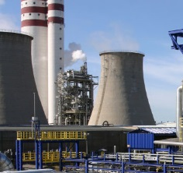

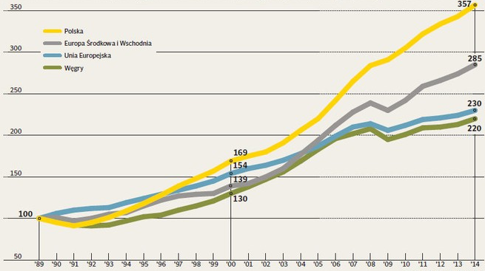
POLAND – Groving Opportunities
6th largest economy in EU and 4rd fastest growing EU country in 2014 (+3.4% GDP growth vs. 1.3% EU average)
The best place to run a business from all Central and Eastern Europe's countries according to the Bloomberg 2014's ranking
Home to well-developed chemical industry and modern environmental protection, major market for chemical and ecological safety and security solutions
Investment incentives - tax exemptions in 14 Special Economic Zones, grants co-financed from the EU
Poland
PKB Per Capita, 100=1989
Central & East Europe
EU
Hungary

Slide 23
Agenda
About the Event
Organizers
Poland – Bridge to Europe
Why participate?

Slide 24
- Why participate?
Chance to join the emerging global market for chemical and environmental safety and security,
All stakeholders engaged in enhancing chemical safety and security at one place,
Latest trends, training sessions, B2B meetings,
The Summit and the Fair will offer the participants a broad media coverage and presence in social media and Internet,
Possibility to organize the National Pavilion,
Logistic and organizational support for the participants.

Slide 25
Thank You
Looking forward for our cooperation.

